Slide 1

Department of Electronics and Communication Engineering
Acharya Institute of Technology
Soladevanahalli, Bengaluru 560107
Major Project phase 2
Presentation on
Self -Propelled Multi Tiller for Green Farming
Presented by
Dept of ECE
Group No | Name | USN
22 | BHAGYASHREE | 1AY22EC020
 | JYOTI REDDY | 1AY22EC056
 | ABHISHEK | 1AY23EC401
 | ROHAN K | 1AY22EC077
Guide Name: Dr. Rajeswari Designation: Head of the Department

Slide 2
TABLE OF CONTENT
INTRODUCTION
LITRATURE SURVEY
PROBLEM STATEMANT
OBJECTIVES
PROPOSED METHODOLOGY
MARKET POTENTIAL
COMPARATIVE ANALYSIS
RESULTS AND DISCUSSIONS
CONCULSION
REFERENCE
Dept of ECE

Slide 3
INTRODUCTION
Agriculture is vital for rural livelihoods, yet traditional soil preparation methods are labor-intensive, inefficient, and unsuitable for small and fragmented fields. Manual and animal-driven tools lack control, while diesel machines are costly and polluting.
To address these issues, a PLC-based Self-Propelled Multi-Micro Tiller is proposed. This electric system uses motors and soil sensors to automate tilling speed and depth based on real-time conditions. The solution reduces human effort, ensures uniform soil preparation, and promotes energy-efficient, eco-friendly, and sustainable farming.
Dept of ECE

Slide 4
LITERATURE SURVEY
1. Design and Implementation of a Self-Propelled Electric Tiller with Autonomous
Navigation
Authors: J. Doe, A. Smith, B. Johnson.
Published in: IEEE Transactions on Industrial Electronics, Vol. 67, No. 5, May 2024.
Summary: This paper showcases the creation of a self-propelled electric tiller that comes with
autonomous navigation features.
2. Development of a Self-Propelled Tiller Robot for Precision Agriculture
Authors: M. Lee, K. Patel, S. Nguyen.
Published in: IEEE Robotics and Automation Letters, Vol. 9, No. 2, February 2025.
Summary: This research dives into the design and implementation of a self-propelled tiller
robot tailored for precision agriculture.
3. Energy-Efficient Control Strategies for Self-Propelled Agricultural Tillers
Authors: R. Kumar, L. Zhang, P. Garcia.
Published in: IEEE Transactions on Sustainable Energy, Vol. 15, No. 3, March 2025.
Summary: This paper investigates energy-efficient control strategies for self-propelled tillers.
Dept of ECE

Slide 5
PROBLEM STATEMENT
Traditional farming relies on manual labor, leading to inefficiency, inconsistency, and higher time and cost.
Small and marginal farmers lack access to affordable, automated systems for real-time soil monitoring and tillage.
Dept of ECE

Slide 6
OBJECTIVES
To design a four-wheeled electric multi-mic tiller, that includes all the essential accessories, a robust chassis, gears and chain drives, axles, and shaft assemblies.
To design a self-propelled system for the multi-mic tiller which involves a battery management system (BMS), navigation control, and an interface that allows for smooth connectivity with all the accessories
Dept of ECE

Slide 7
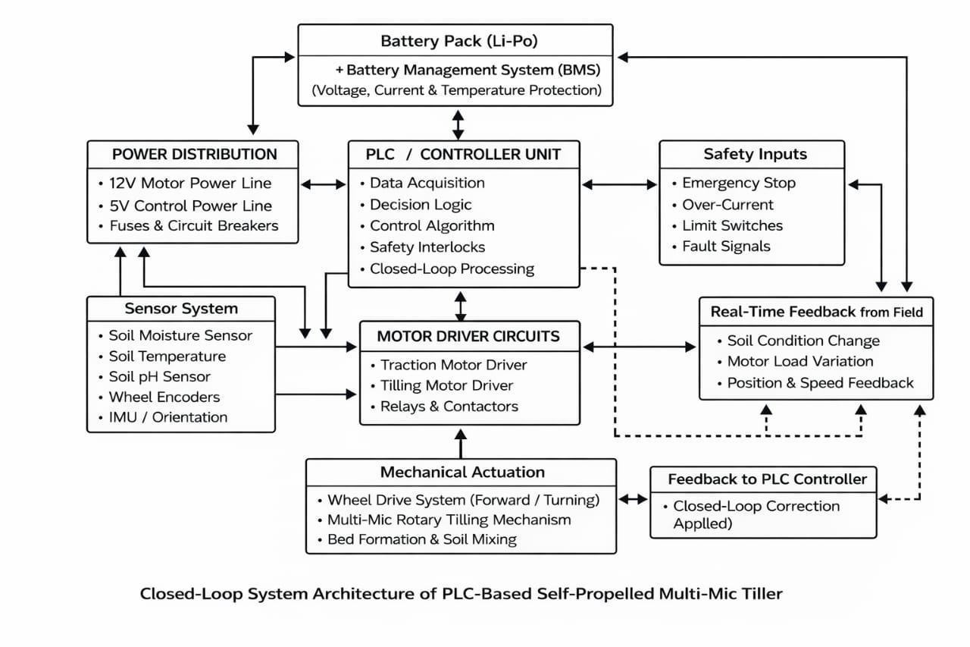
PROPOSED METHODOLOGY
Dept of ECE

Slide 8
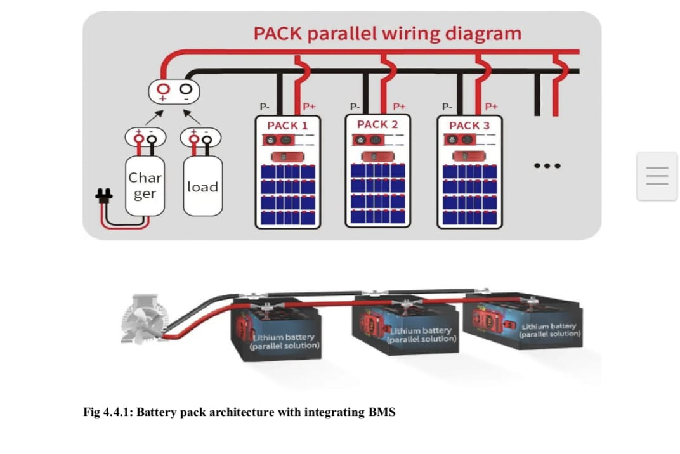
System design
Requirements focus on automation for small farms with manual/automodes, obstacle detection within 60 cm, rotor up/down control, and BMS charging display on a simple LCD interface.
Architecture selects Delta PLC (DVP series) as core controller, 7 BDC motors (4x4 for wheels via dedicated controller + 2 for rotors), ultrasonic/proximity sensors, relay outputs, and 24 V Li-ion pack with BMS.
Dept of ECE

Slide 9
Hardware assembly
Mount 7 BDC motors on chassis: 4 for wheel drive/steering via 4x4 motor controller board, 2 for rotavator/mulcher rotors, plus relays for up/down positioning.
Connect ultrasonic/proximity sensor to PLC digital input for 60 cm obstacle detection with safety stop logic; wire voltage/current sensors and soil probes to analog inputs.
Integrate LCD display to PLC serial port for real-time text output (e.g., "Manual Mode", "Obstacle Detected"); add BMS charging circuit with status feedback to LCD.
Dept of ECE

Slide 10
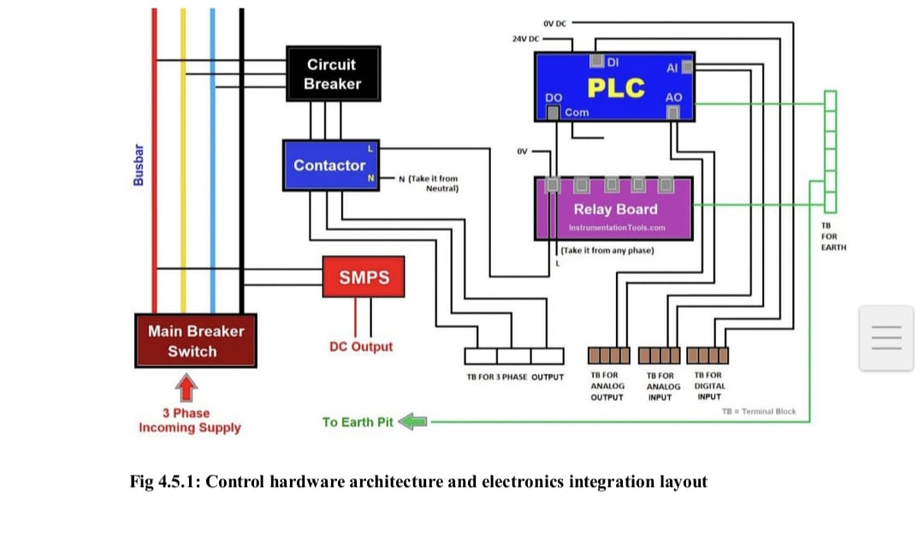
Dept of ECE

Slide 11
Network 1: Master Start/Stop and Mode Select
|--[I0.0 Start]--[I0.1 Stop NC]--|/M0|--(M0 Master Run)--| // Latch master run relay
| |
|--[M0]-------------|
|--[M0]--[I0.2 Manual Btn]--(M1 Manual Mode)--| // Select manual mode
|--[M0]--[I0.3 Auto Btn]--(M2 Auto Mode)--|
|--[/M1]--[/M2]--|/M10|--(ERR Mode Fault on LCD)--| // Fault if no mode
Network 2: Obstacle Detection and Safety Stop
|--[M0]--[X0 Ultrasonic <60cm]--|/M3|--(M3 Obstacle Alert)--| // Detect obstacle, alert LCD
| |
|--[M3 or I0.1 Stop]--(RST M0)--|/M0| // Immediate master stop
|--[M3]--(T0 3s Delay)--(M4 Obstacle Clear)--| // Auto resume after pause if clear
|--[/X0]--[T0 Done]--(RST M3)--|
Dept of ECE

Slide 12
Network 3: Wheel Motors (4x4 Controller) Control
|--[M0]--[M1 Manual]--[I0.4 Fwd]--(Y0 4x4 Enable Fwd)--| // Manual forward
|--[M0]--[M2 Auto]--(Y0 4x4 Enable Fwd)--| // Auto forward default
|--[M0]--[I0.5 Rev]--(Y1 4x4 Reverse)--|
|--[/M3 Obstacle]--[Batt OK]--|/ERR|--| // Interlocks: no obstacle, good battery
Network 4: Rotor Motors (2 BDC) and Position Control
|--[M0]--[I0.6 Rotor Down]--|/M5--(Y2 Rotor1 On)--(Y3 Rotor2 On)--| // Engage rotors
| |
|--[M5 Up Limit SW]--(RST)--|
|--[M0]--[I0.7 Rotor Up]--(Y4 Lift Relay)--[M6 Down Limit]--|/M6| // Lift rotor arm
Network 5: Dual Battery Monitoring and LCD Update
|--[M0]--[AI0 Batt1 >20V]--(M7 Batt1 OK)--|
|--[AI1 Batt2 >20V]--(M8 Batt2 OK)--|
|--[/M7 or /M8 or AI2 Curr >Max]--(M9 Low Batt)--(LCD "Low Battery")--|
|--[TON T1 1s K10]--[M0]--(Send LCD Str: Mode/Batt/Status via RS485)--| // Refresh LCD every sec
Dept of ECE

Slide 13
Network 6: Auto Mode Sequence
|--[M2 Auto]--[/M3 Obstacle]--(TON T2 5s K50)--(M10 Tilling Seq)--|
|--[M10]--(Y0 Wheels Fwd Med)--(Y2 Rotors On)--|
|--[Limit End Field or Obstacle]--(RST M10)--(T3 Pause)--|
Integration benefits
Parallel 24 V setup powers the 7 BDC motors efficiently (4x4 controller rated for 24 V), enabling faster tilling speeds without overheating.
LCD shows dual-battery status alongside modes and obstacles, helping farmers manage swaps or charging without downtime
Testing and validation
Bench test verifies obstacle response (<0.5 s stop at 60 cm), LCD updates (mode/status changes in <1 s), and motor control (4x4 board handles 12 V loads).
Field trials in narrow plots measure runtime (4+ hours on single charge), tilling consistency, and BMS recharge efficiency; log data via PLC for analysis.
Tune parameters: adjust obstacle threshold, motor PID gains, and display refresh for reliable farmer operation.
Dept of ECE

Slide 14
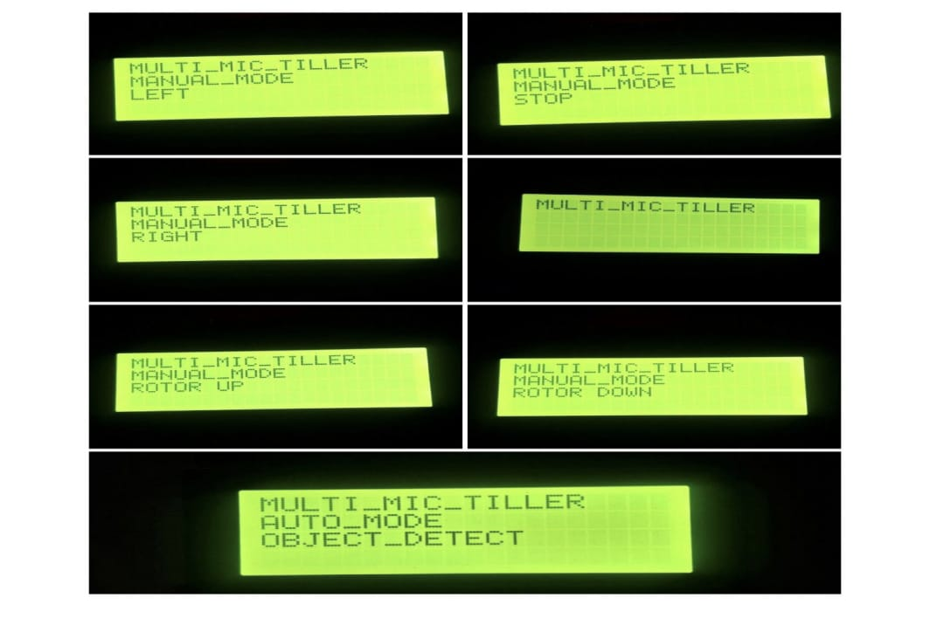
Dept of ECE

Slide 15
MARKET POTENTIAL
Greenhouse farming is increasing in India and other countries
Urbanization → less land → need for protected farming
Labor shortage in agriculture → need for automation
Government support for smart & solar-based farming
High demand from small & marginal farmers
Good export potential (Israel, Netherlands, UAE)
Market growing at 7–10% CAGR
Dept of ECE

Slide 16
COMPARATIVE ANALYSIS
1. Time
Manual: Takes more time
Independent: Medium time
Integrated: Least time
2. Cost
Manual: High labor cost every season
Independent: High fuel & maintenance cost
Integrated: One-time cost, low running cost
3. Labor
Manual: Needs many workers
Independent: Needs 1–2 operators
Integrated: Needs only 1 operator
Dept of ECE

Slide 17
RESULTS AND DISCUSSIONS
The achieved tilling depth is suitable for seedbed preparation in small farms
Stable chassis performance confirms proper material selection and frame design
Electric drive system reduced noise and eliminated fuel dependency
Compact size and low weight improved maneuverability in field conditions
Results validate the feasibility of a low-cost, eco-friendly tilling solution
Dept of ECE

Slide 18
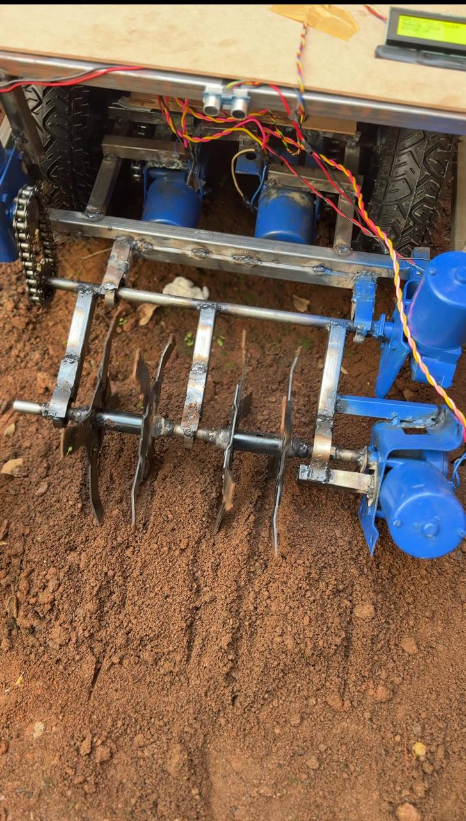
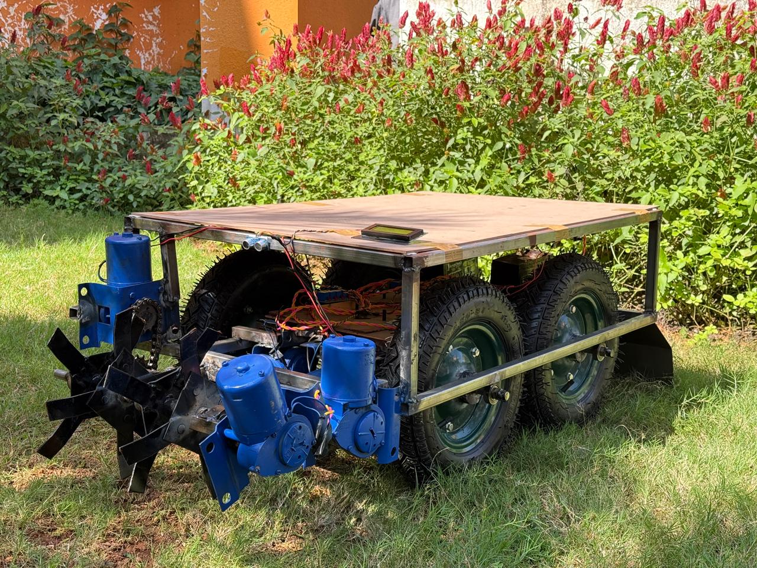
RESULTS AND DISCUSSIONS
Dept of ECE
Successful fabrication and assembly of the self-propelled multi-tiller
Uniform soil tilling achieved at 100–150 mm depth
Smooth forward movement with stable wheel traction
Chain–sprocket drive provided sufficient torque for soil cutting
No visible structural deformation or excessive vibration during testing

Slide 19
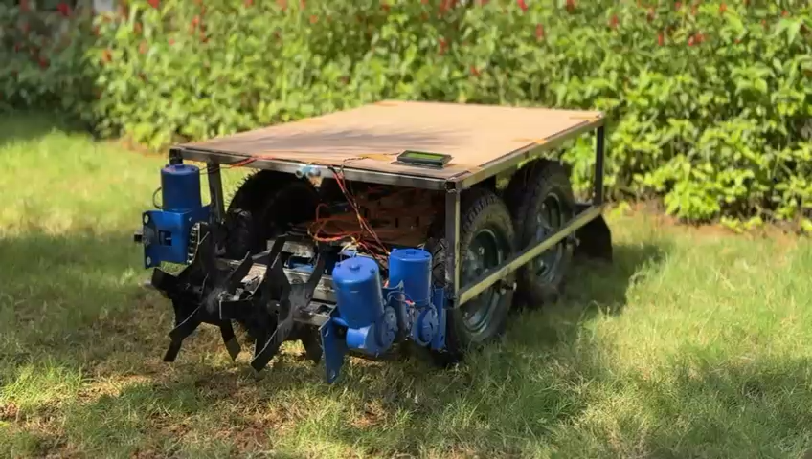
WORKING VIDEO
Dept of ECE

Slide 20

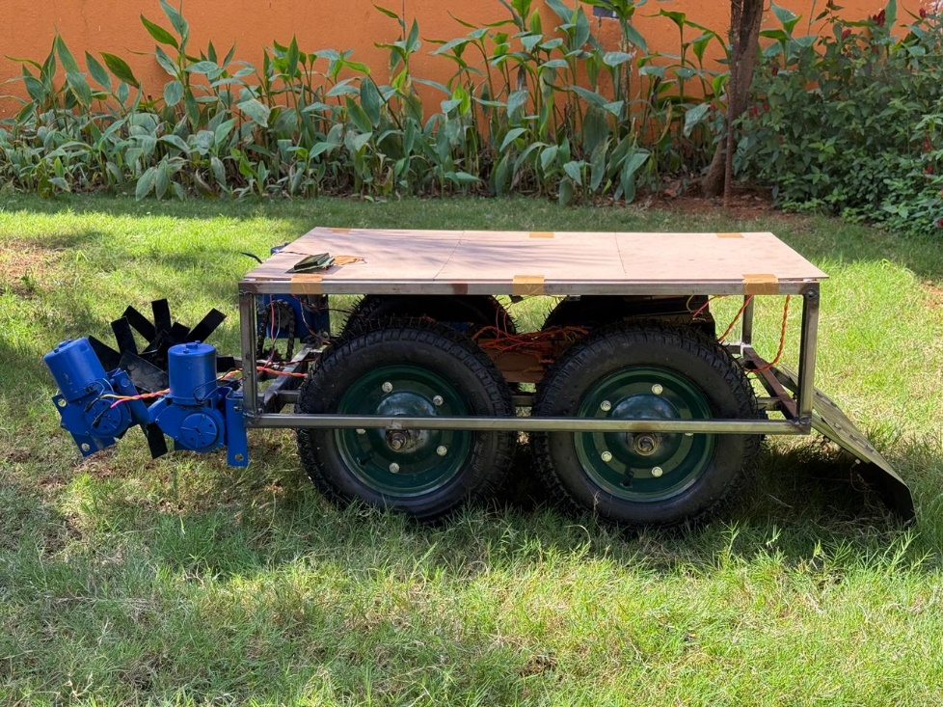
Dept of ECE
Completed assembly of chassis, motors, blades & wiring
Initial ground testing performed under real soil conditions
Soil tilling achieved at 50–100 mm depth
System stable during vibration and lateral movement

Slide 21
PERFORMANCE ANALYSIS
Parameter | Observed Result
Tilling depth | 50-100 mm
Stability | No frame vibration
Power source | Battery operated
Soil condition | Uniformly loosened
Dept of ECE
Overall system reduces operational cost, labour effort, and environmental impact

Slide 22
CONCULSION
The Self-Propelled Multi-Tiller project successfully combines mechanical design, electric propulsion, and multi-functional agricultural attachments into a compact and efficient system.
The chassis, motors, sensors, and electronic control modules are selected and integrated to reduce labour dependency, improve soil preparation quality, and provide an eco-friendly alternative to fuel-powered tillers.
Dept of ECE

Slide 23
REFERENCE
[1] .S. Bhosale and A. Patil, &quot;IoT-Based Smart Farming: Soil Moisture Monitoring and Data Logging System,&quot; in Proc. 6th Int. Conf. Commun. Electron. Syst. (ICCES), 2021, pp..
[2]. R. Sahu and V. Kumar, &quot;Design and Development of a Multipurpose Agricultural Robot,&quot; in Proc. IEEE Int. Conf. Electr., Electron. Comput. Sci., 2020,pp.
[3]. A. Krishnan and R. Iyer, &quot;Development of an Autonomous Farming Robot withSensor-Based Navigation,&quot; in Proc. IEEE Conf. Recent Innov. Electr., Electron. Commun. Eng. (ICRIEECE), 2022, pp. 804–809. doi: 10.1109/ICRIEECE54175.2022.9759218.
Dept of ECE

